Slide 1






What Pokémon GO can teach us about designing innovative, collaborative activities
You will need:
QR Scanner
Cardboard Camera

Slide 2




Slide 3


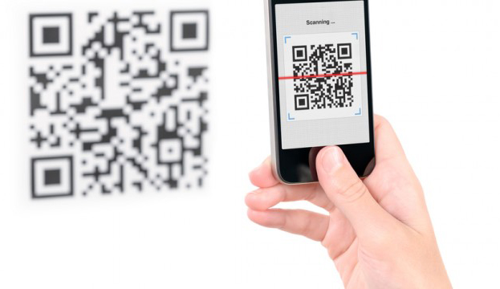




Prof Trent’s Lab
Instructions
Scan the QR code on your MarcelDex.
Open the VR image in Cardboard Camera.
Discover your team!

Slide 4
Instructions
Form a party of three with people from other teams.
Follow the clues in your MarcelDex to find the ProfStops.
Scan your team’s code and complete the activity together to earn a badge for your party and points for your team.
Use the MarcelDex to record anything of interest.
Try to collect all nine badges and earn the most team points by 11:55am!

Slide 5









Calculating Results…

Slide 6
Calculating Results…
ProfTrent.com/PDDresults

Slide 7

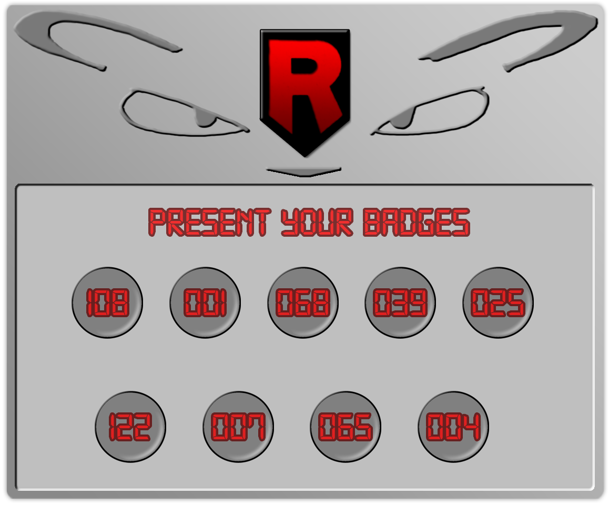
Narrative
Rocket Headquarters

Slide 8
Theme Your Activity
Create a narrative
  “The graphics were great, story amazing, theme was fun and captivating.” – Student
  “The introduction was really creative and entertaining!” – Lynette
  “The best part was the creativity. It was a fun story to follow.” – Student
Align your narrative with your activities
  “The activities also related well with each hint given.” – Student
  “Honestly, it was very similar to Pokémon, and really fun to play.” – Alanna

Slide 9
Narrative
Control
Challenge

Slide 10
Vary & Focus Activities
Increase Motivation
Campus Collaboration
Differentiate Instruction & Assessment
Discourage Cheating
Encourage Out-of-Class Engagement
  “All activities involved interacting/using the materials learned in class. I enjoyed the class and enjoyed this game very much!” – Lynette
  “[It was a] very unique and innovative way to keep us interested in practicing French outside of the typical class hours.” – Pablo

Slide 11





Example Activities
Answer questions about your physical appearance and personality, then create an avatar (AvatarMaker.com)

Slide 12
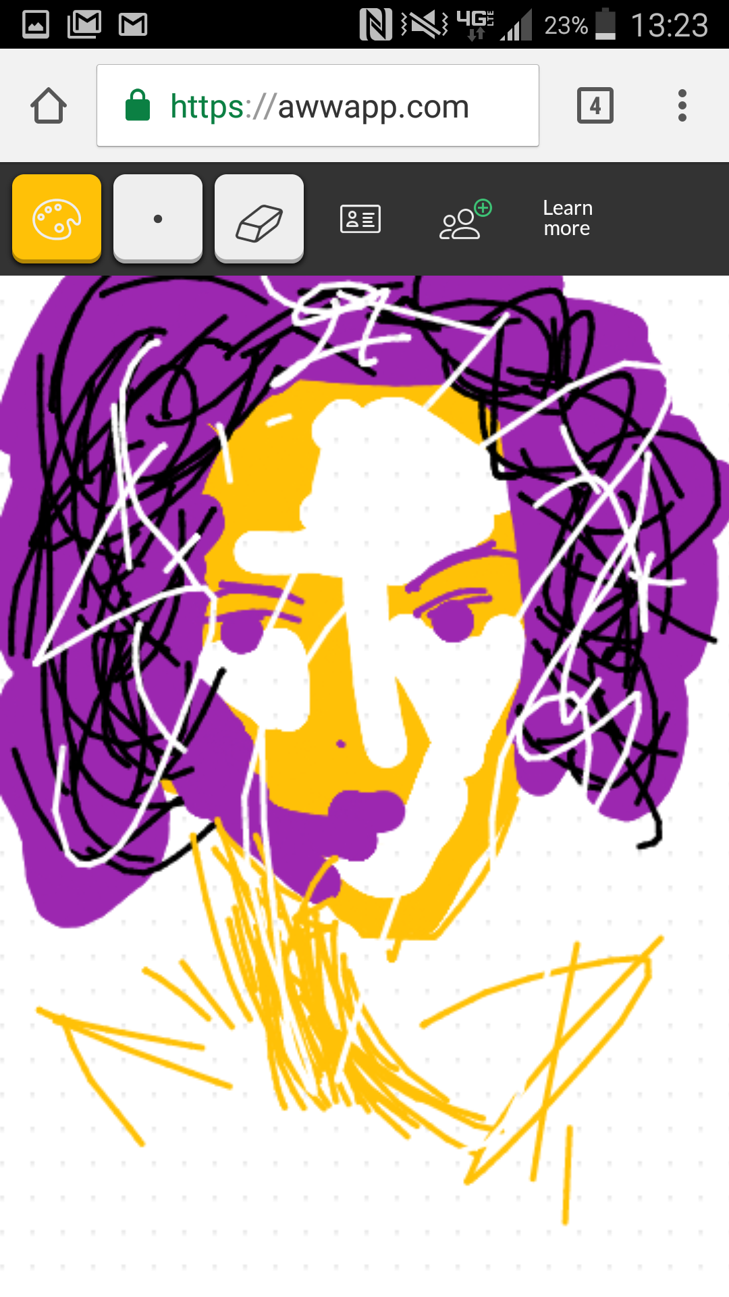
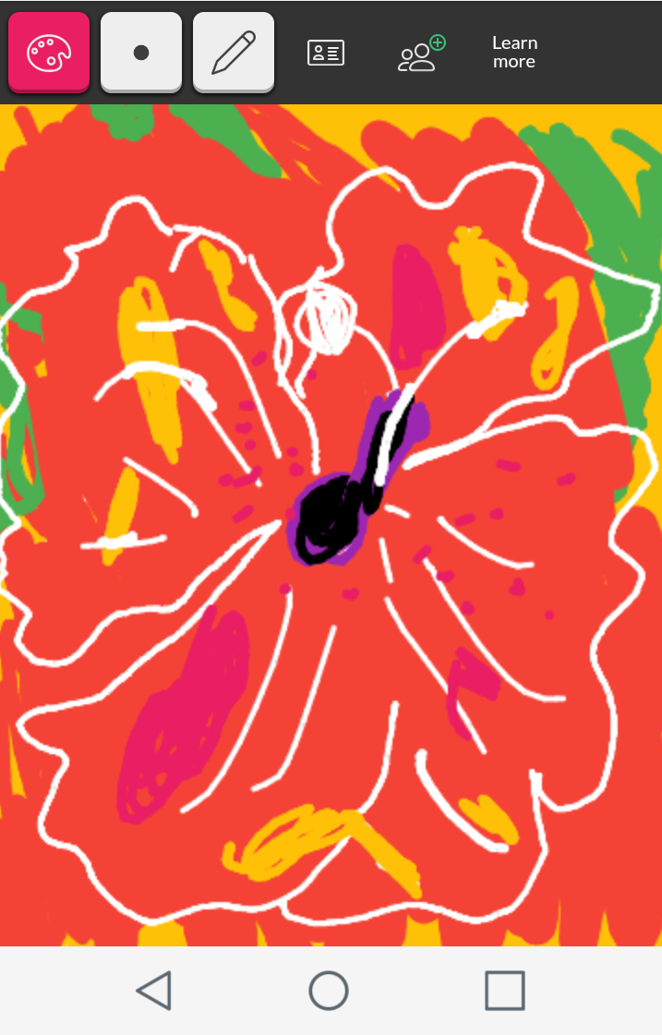
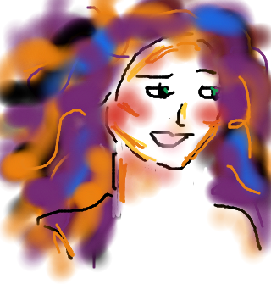
Example Activities
Describe your favorite painting in Bailey Hall exhibit, then attempt to draw it using a web tool (AwwApp.com)

Slide 13
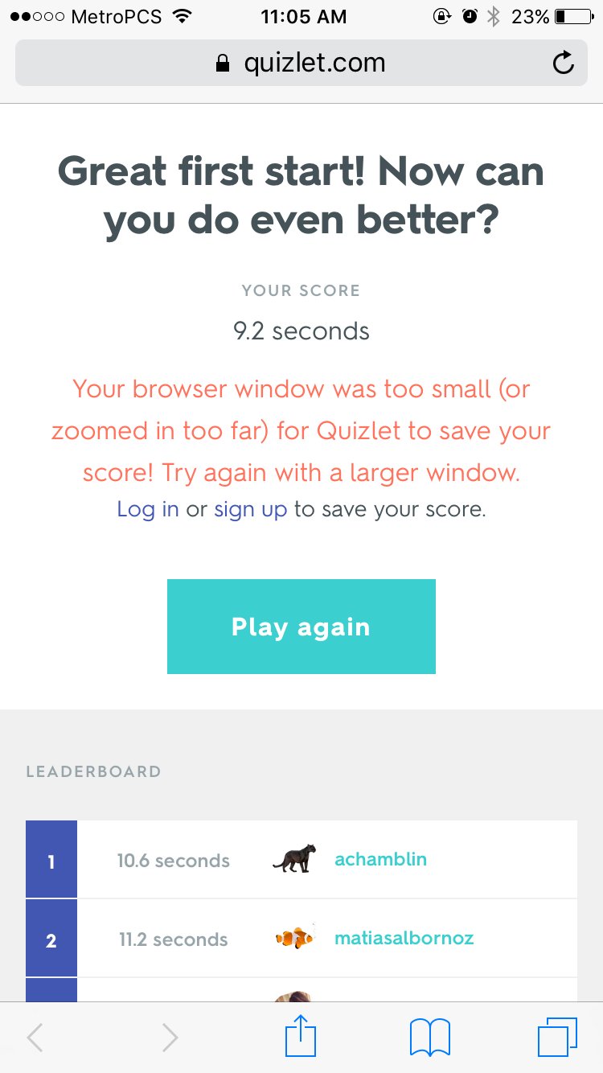
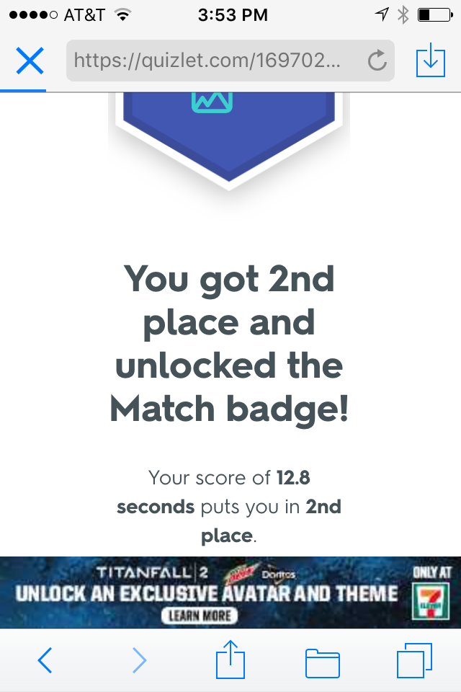
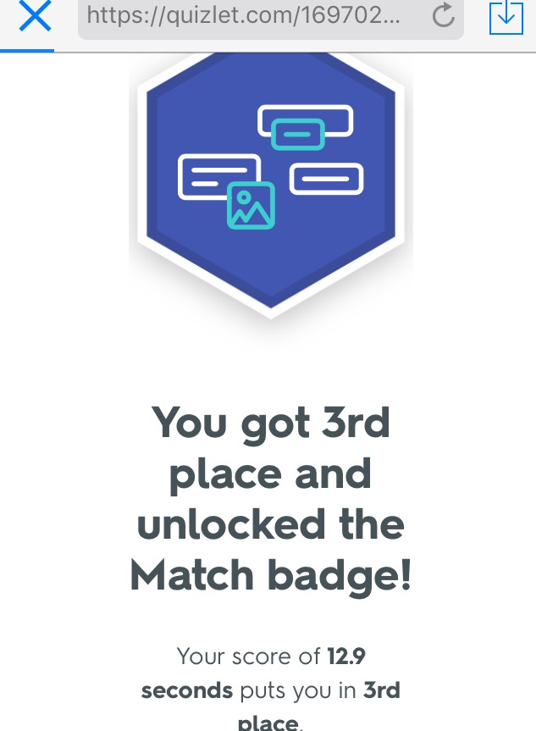
Example Activities
Play games and compete for record scores (Quizlet.com)

Slide 14
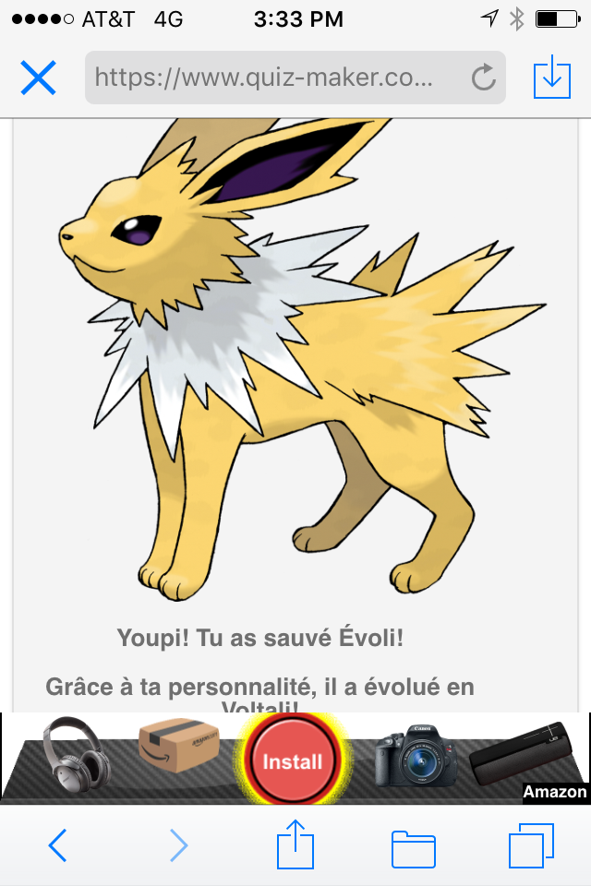
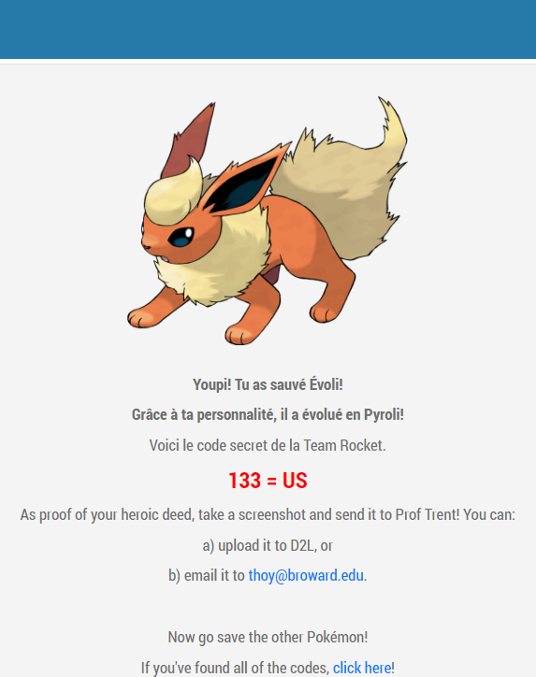
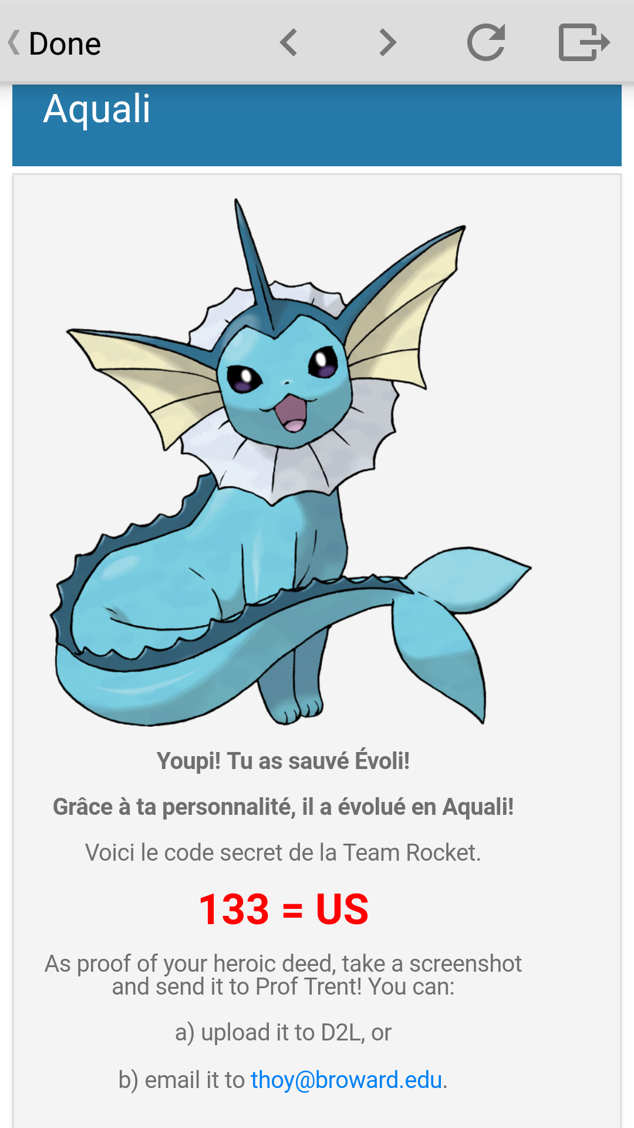
Example Activities
Take a quiz with branching results (Quiz-Maker.com)

Slide 15
Choose Locations Wisely
Challenge is good!
  “It was interesting trying to find them; they were clever hiding spots. I felt accomplished when I found one.” – Student
Thrill of the hunt!
  “I enjoyed actually going around campus and finding the codes.” – Natalia
  “I really enjoyed looking for the ProfStops. It helped me familiarize myself with the campus.” – Annie
  “[It] required me to be outside and actually walk around.” – Pablo
Don’t jeopardize accessibility!

Slide 16

Gauge Time Frame
Plan from the beginning how you will deploy activity and how long students should spend

Slide 17
Narrative
Control
Challenge
Risk
Feedback
Progress
Mastery
Social
Collaboration

Slide 18
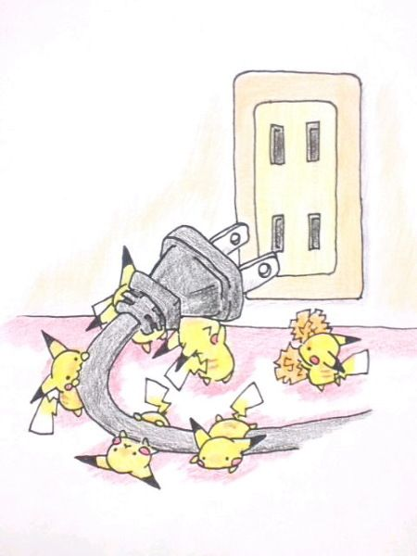
Let Students Collaborate
Allow students to work together, but still submit individually
アグリパッカー (Aguripakkaa)
http://www.pixiv.net/member.php?id=2953980

Slide 19
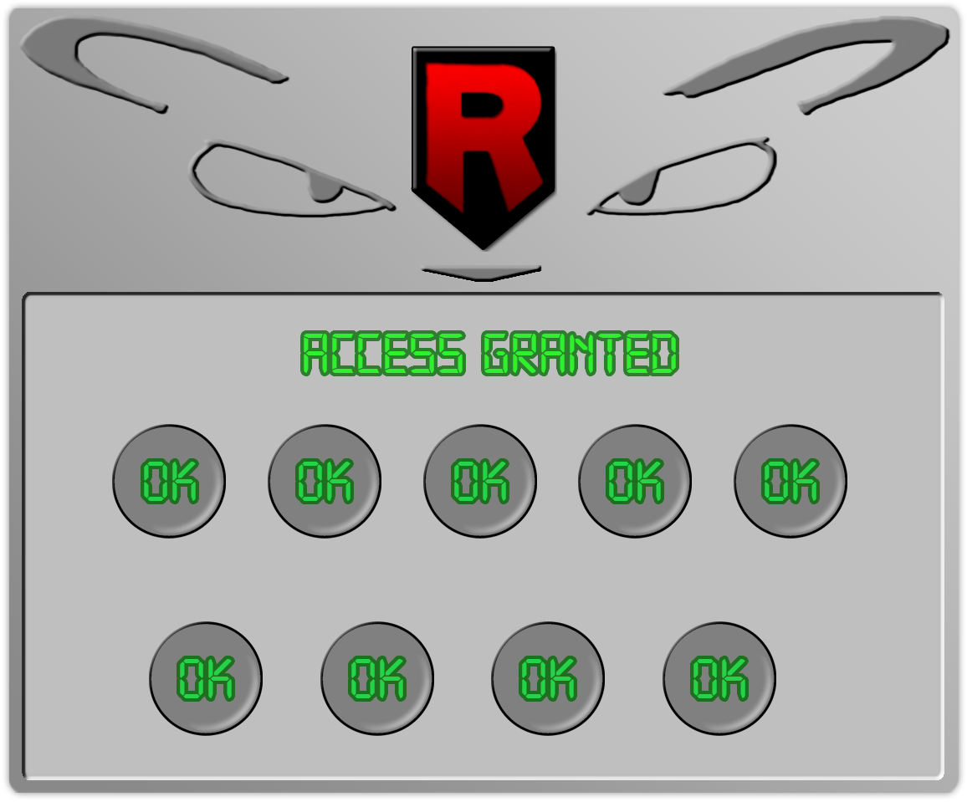
Narrative
Control
Challenge
Risk
Feedback
Progress
Mastery
Social
Collaboration

Slide 20






Final Challenge
You may have outsmarted my henchmen…
…but you’ll never be strong enough to defeat me!
This legendary Pokémon will be mine… FOREVER!
MUAH HA HA!
To topple Team Rocket’s nefarious leader, join forces!
Can you devise a plan clever enough to take him down?

Slide 21
Discussion
How might you gamify aspects of your courses or existing assignments and activities?
What are some themes or activities you might include?
How could you collaborate with another instructor or department?

Slide 22

Creation Badge
Your hard work has saved the last Pokémon and earned you the ultimate badge!
Now it’s up to you to create your own epic adventure!

Slide 23






Q & A
ProfTrent.com
TrentHoy
ProfTrent

